Slide 1

Enthuse: Foundation of Data Science in Python
Instructors:
Thangavel Prasanth
Palikarpau Raman
Ho Mun Kit

Slide 2
Program Schedule
Time | Program
9:00 – 9:30 | Introduction: What is Data Science
9:30– 11:00 | Introduction to Python
11:00 – 12:00 | Introduction: Python Libraries
12:00 – 13:30 | Lunch
13:30 – 15:00 | Hands-on Mini Projects

Slide 3
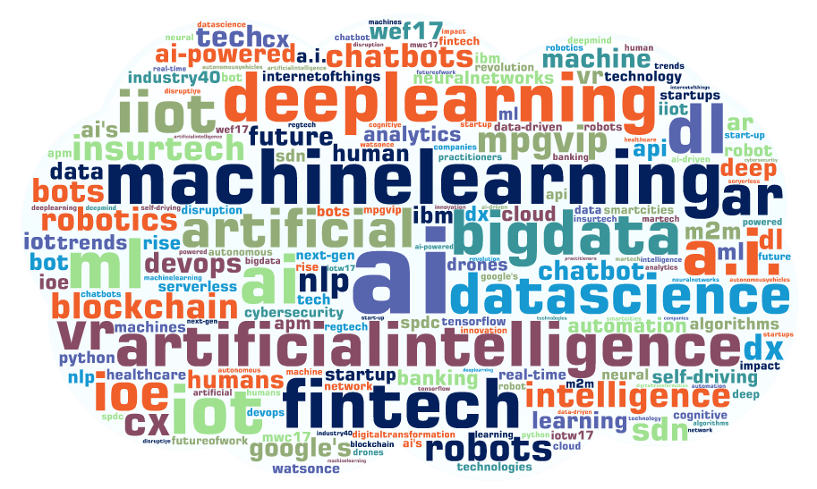
What is data science?
Notes:
can fill up with more information about Iot, machine learning and other stuff

Slide 4
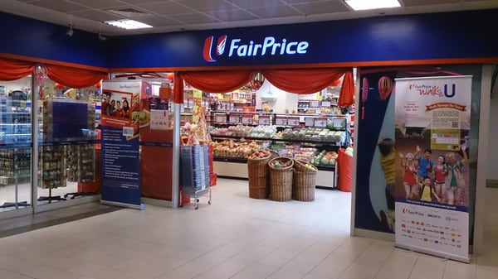
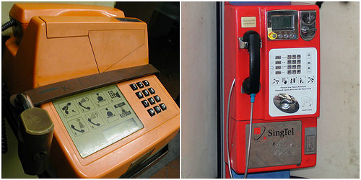
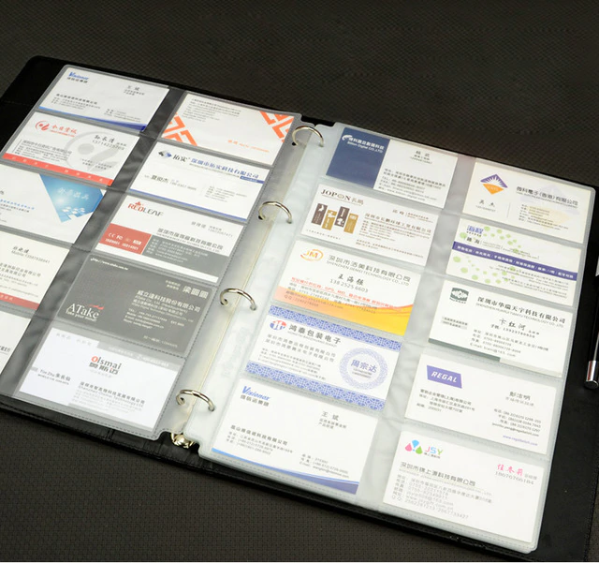
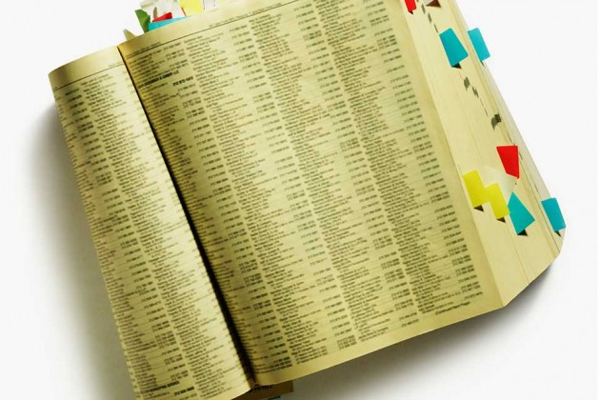
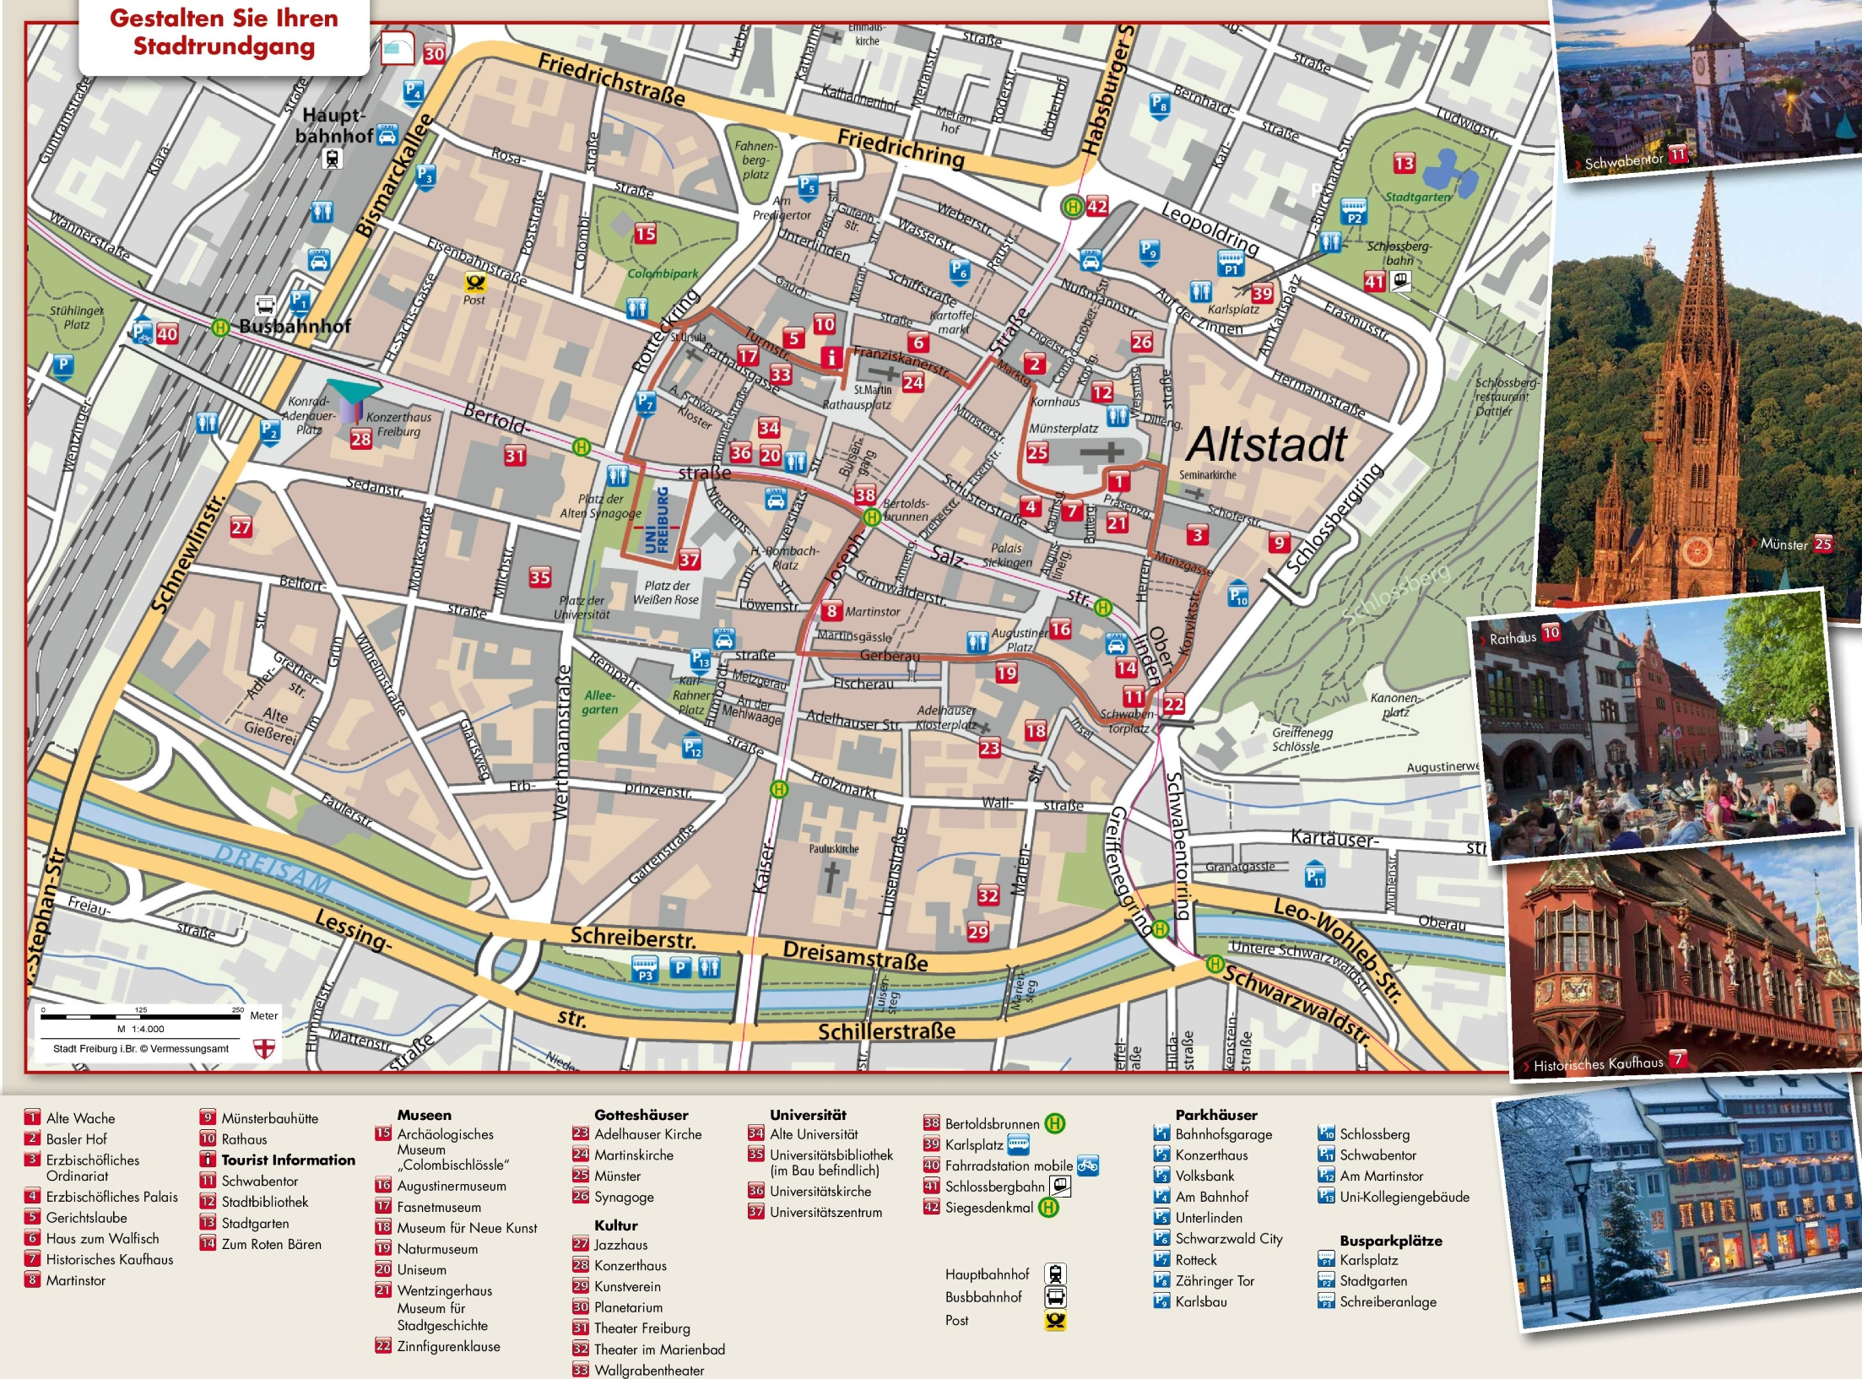
Data and information from places you hardly notice
Notes:
Data and information are available at places you don’t usually look out for

Slide 5
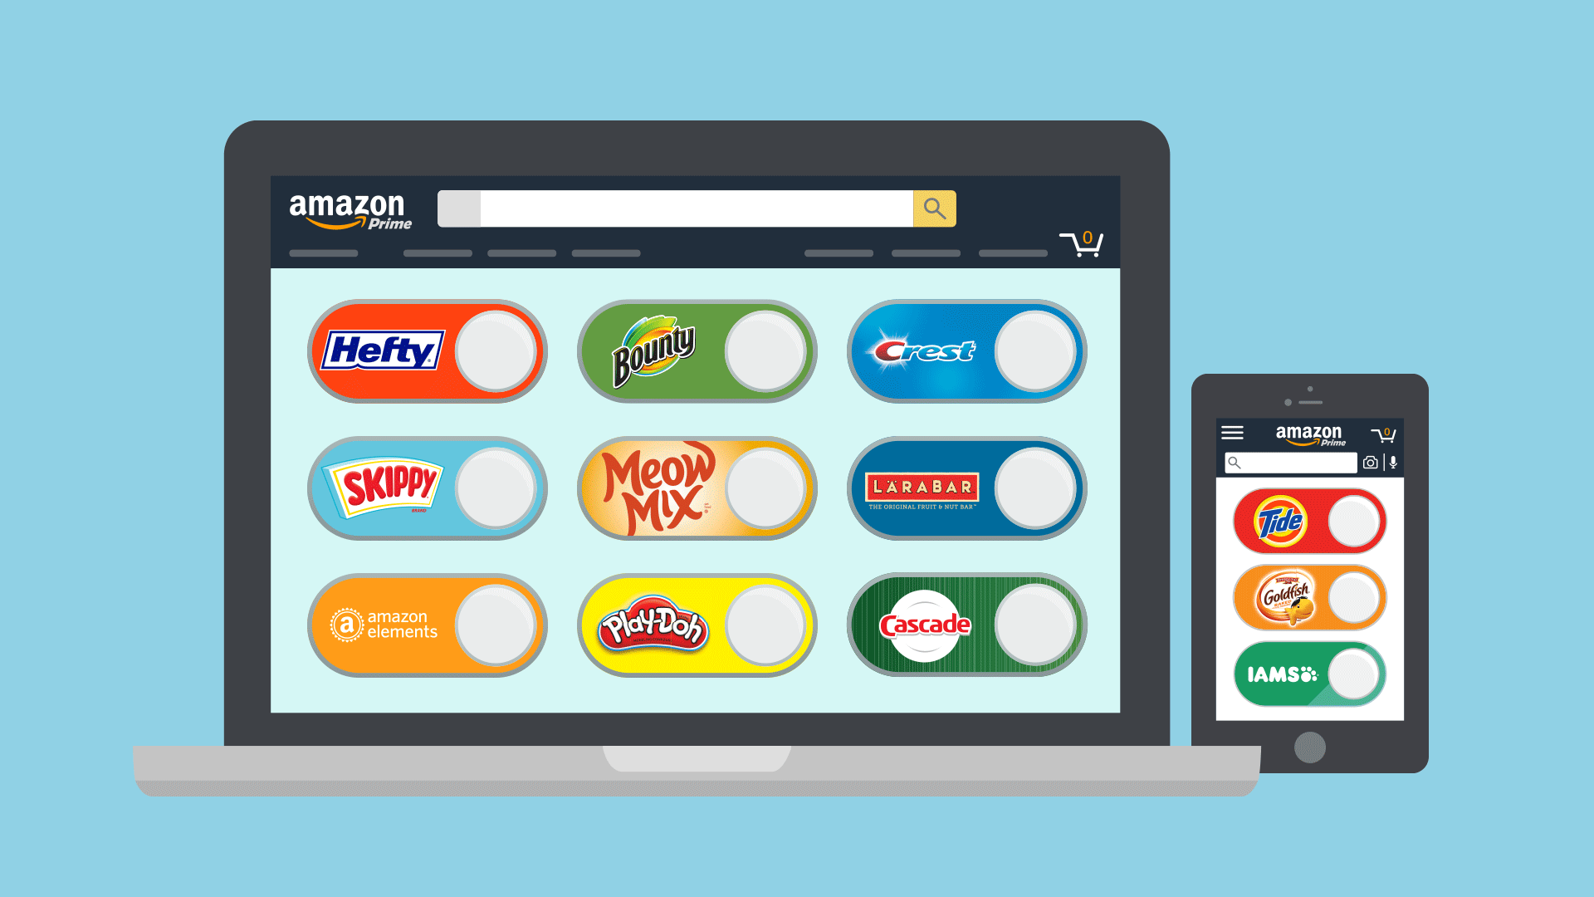
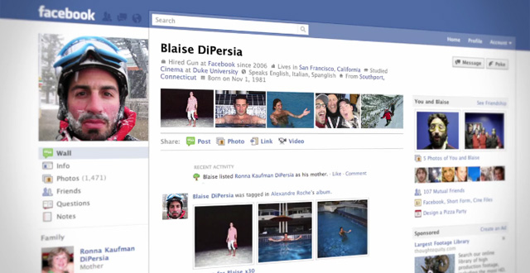
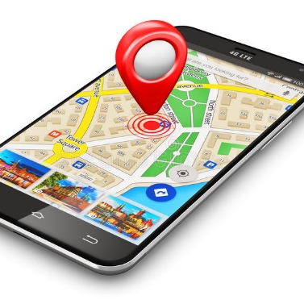

We are consuming and generating data every day

Slide 6
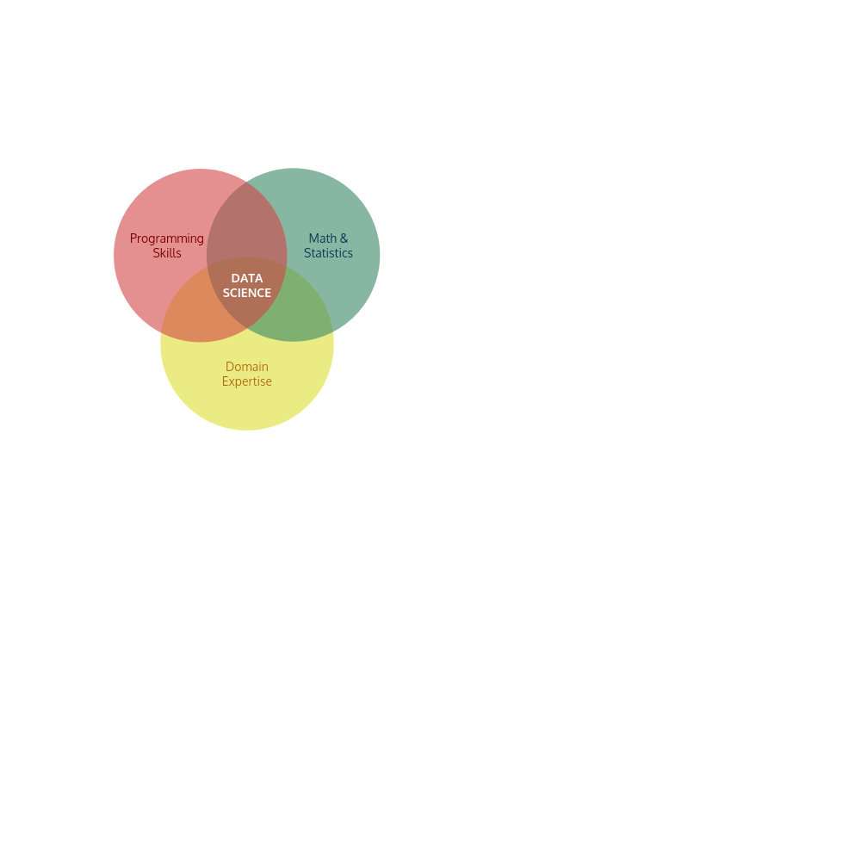





Data science
Exploration and analysis of data in order to discover meaningful patterns to answer critical questions
“Based on the websites this person has visited over the past month, what are the chances that he will click an advertisement from this category?”
“What kind of promotional events should we organize to help new sellers gain attention?”
“Which of these people most likely belong to the same interest group?”
f
Notes:
Remove intersection nouns
change

Slide 7
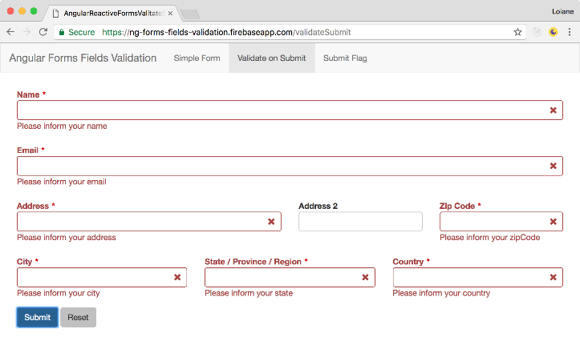
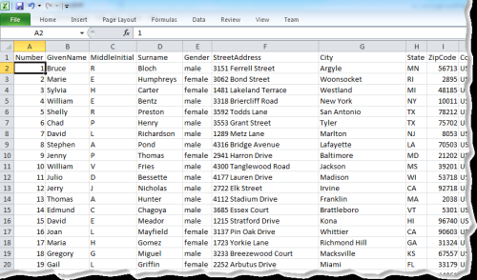
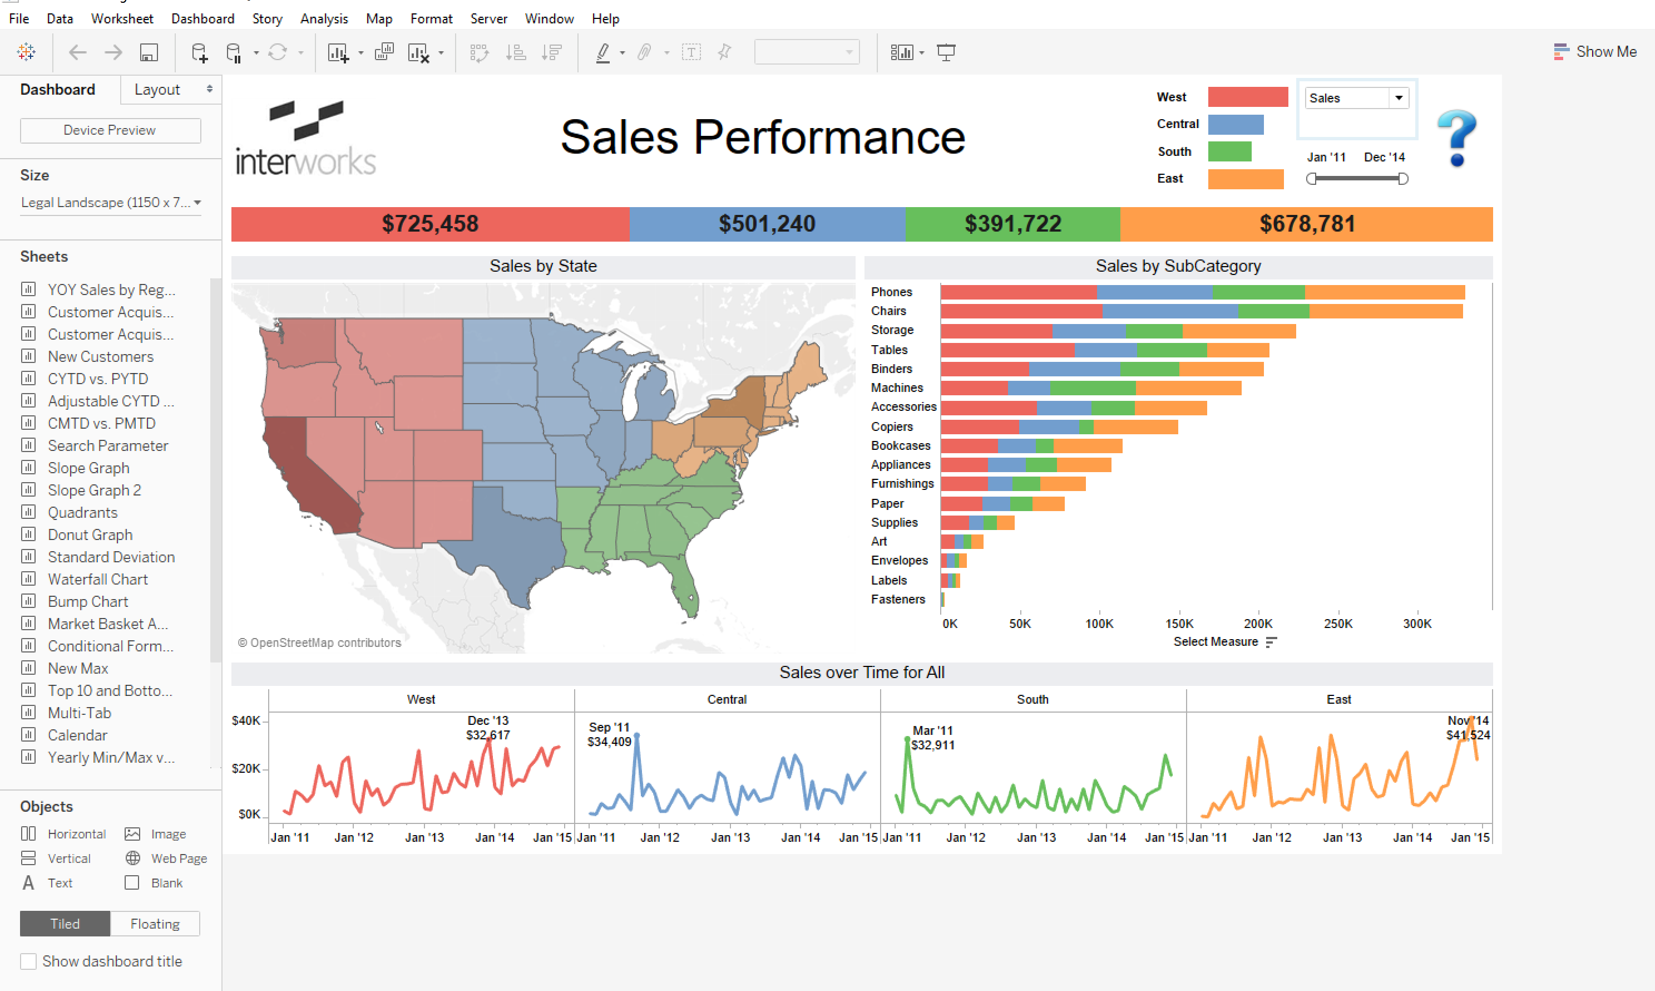
Data
Information
Knowledge
OBJECTIVE: Extract knowledge to automate decision-making of identical problems in the future

Slide 8
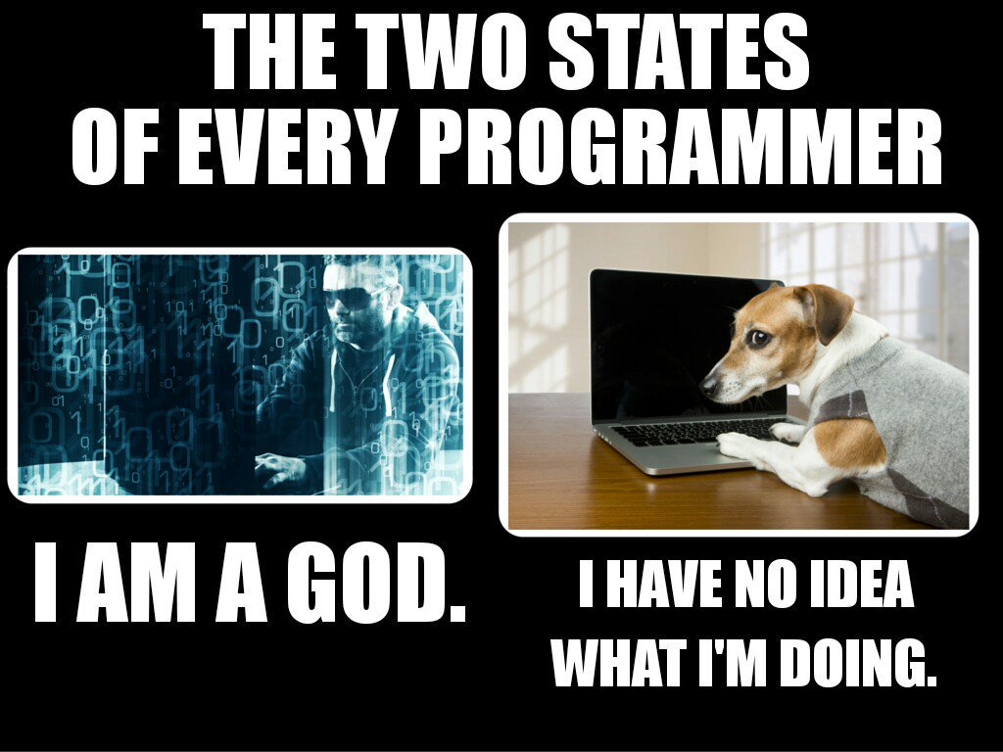
Computer programming
How do I tell a computer to accomplish a certain task?

Slide 9
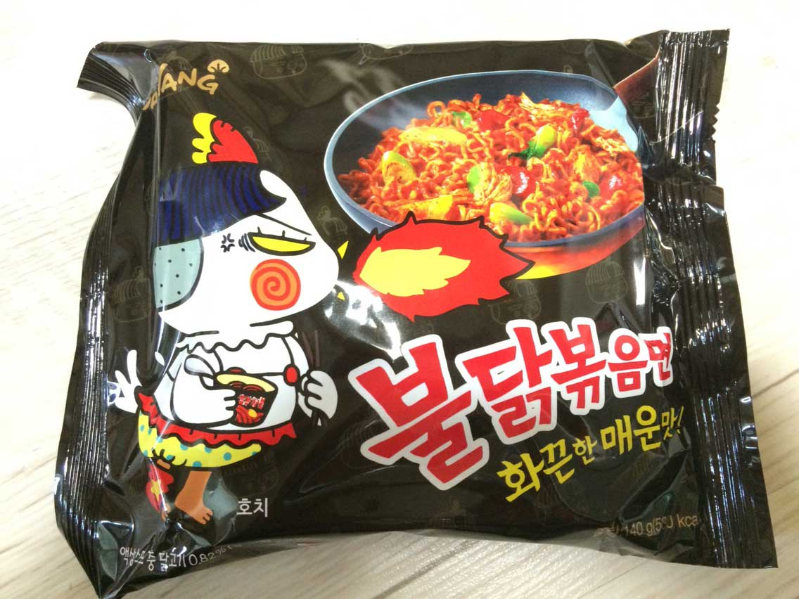
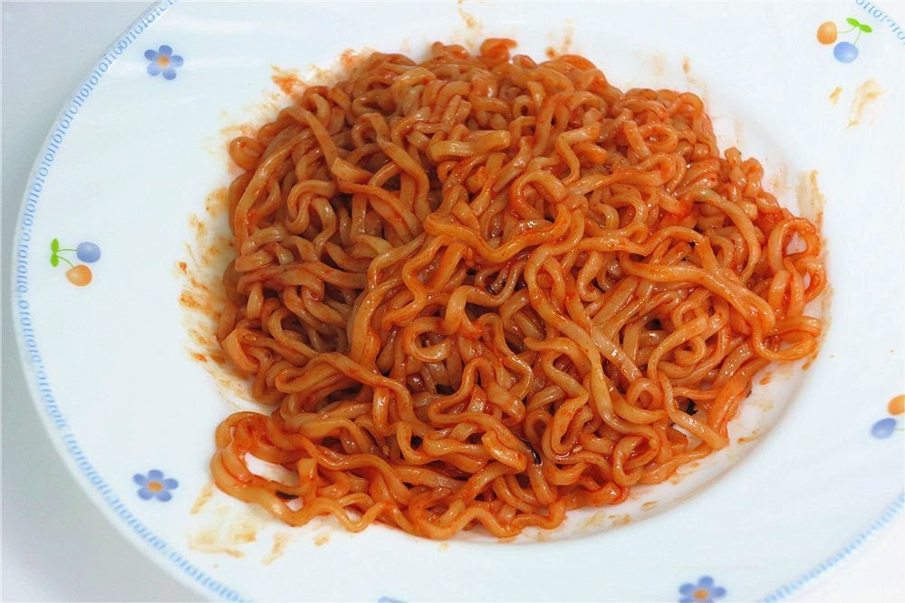
Exercise: How do I cook this pack of instant noodles?
Tips:
What do you need?
Which indicators do you look out for?
Noodles in packaging
?
...
?
Ready to eat

Slide 10
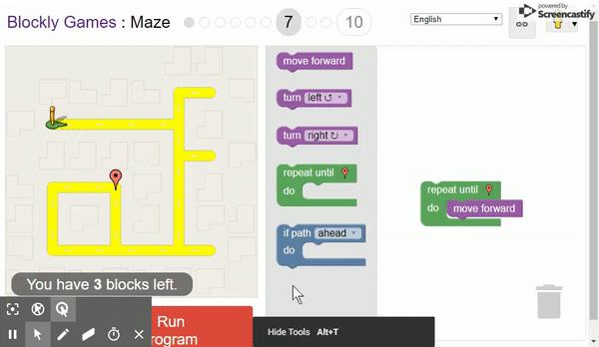
Quick hands-on: Robot Guidance
Link: https://bit.ly/1zIvq2z

Slide 11
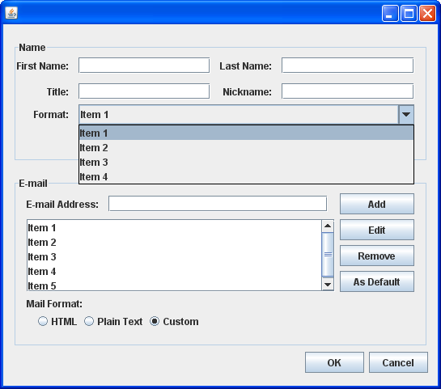
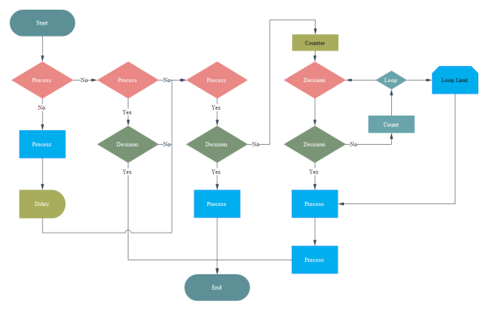
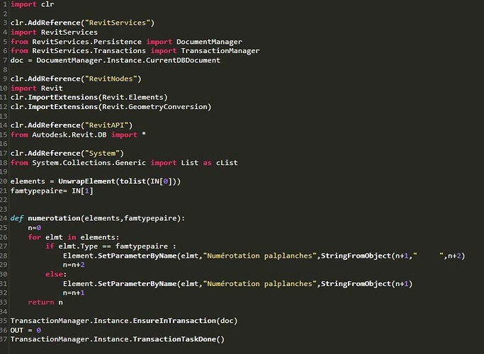
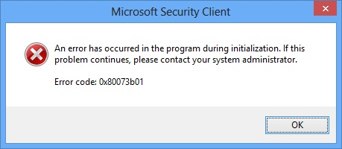
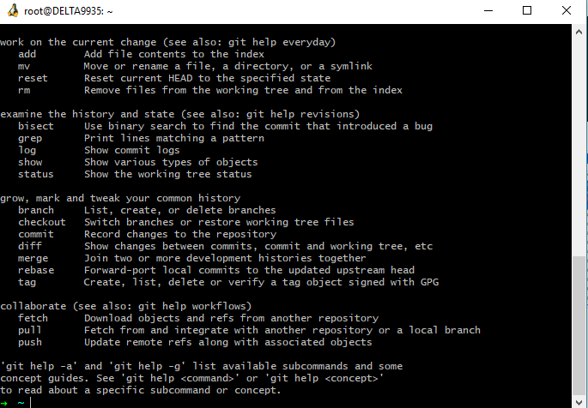
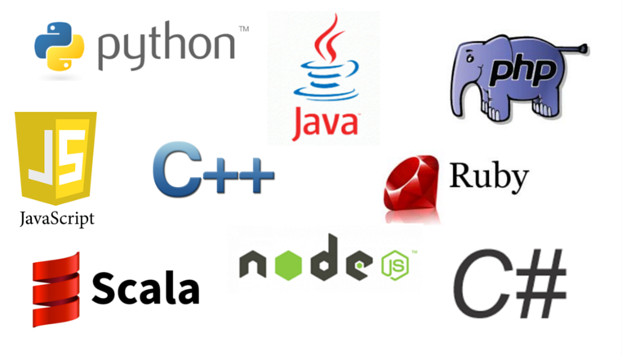
Classic software
Decompose the problem
Design algorithms
Measure performance
Integrate into a system
Notes:
each line of code, the programmer identifies a specific point in program space with some desirable behavior.
Cooking example recipe. Cooking instant noodle... prepare toast....
https://blockly-games.appspot.com/?lang=en

Slide 12
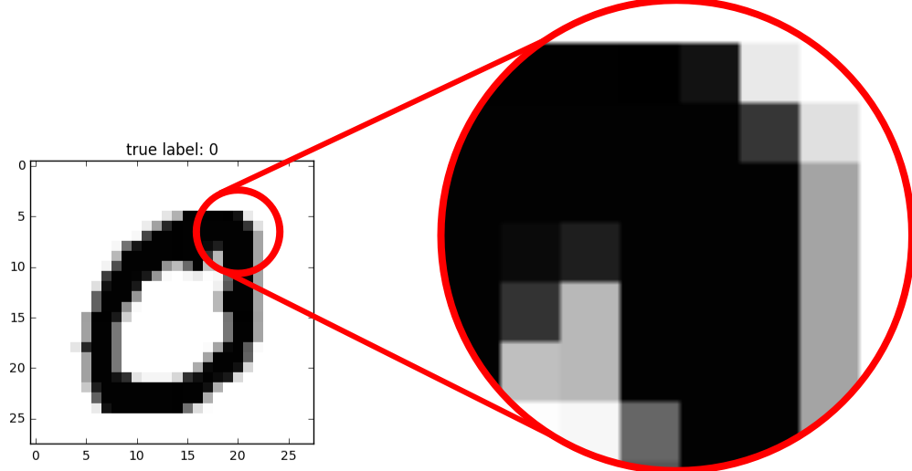
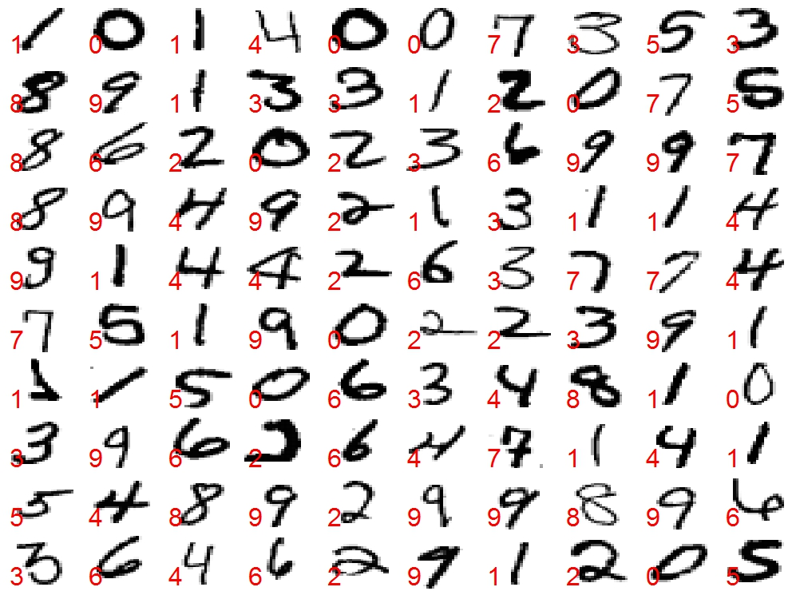
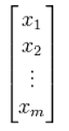
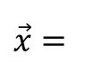
Programming a more complex task
Handwriting recognition
task
Classifier algorithm
0
Each 8-bit pixel takes the value of 0-255
$$\vec{x}=$$

Slide 13
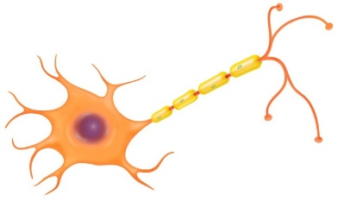
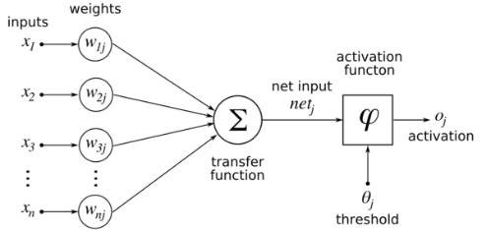

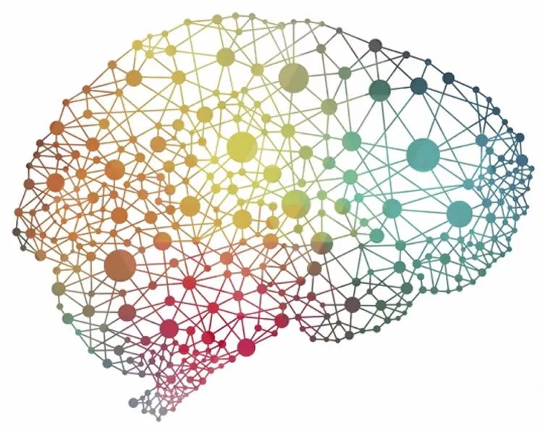

Neural networks
ARTIFICIAL
NEURON
x 100 ...
?
DEEP NEURAL NETWORK

Slide 14
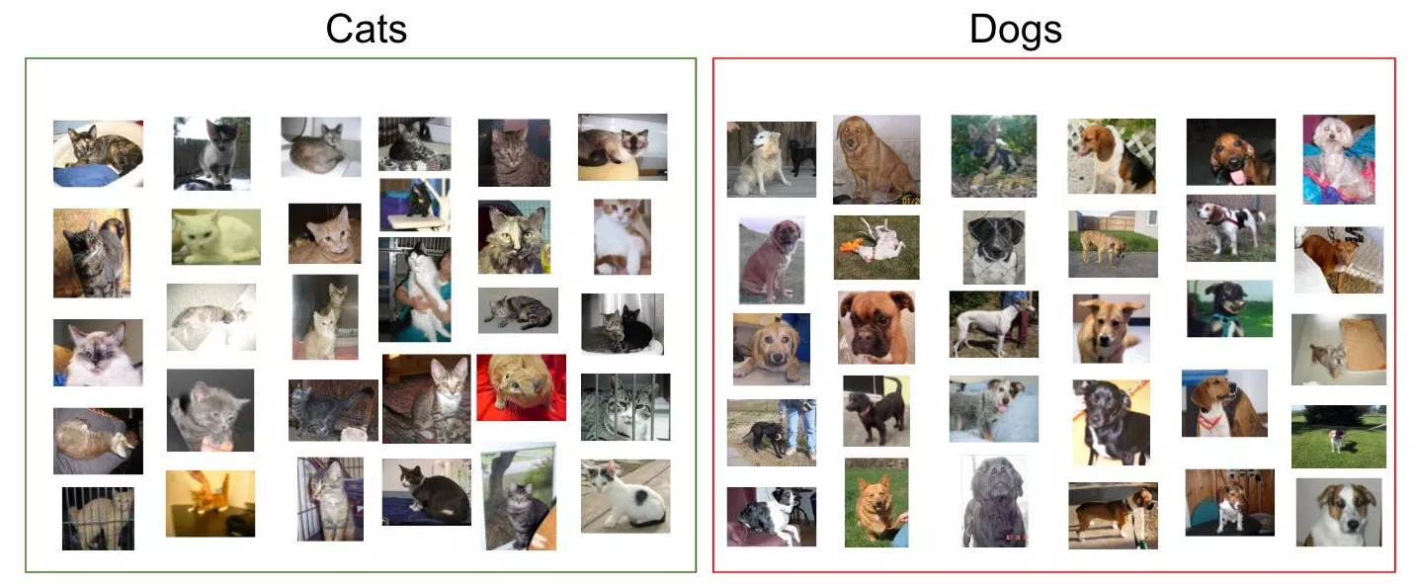

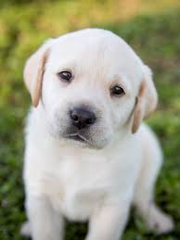

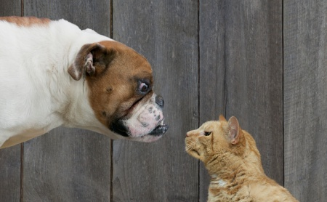
Machine Learning Algorithms
CAT
CAT
Prepare lots of labelled data
Write rough skeleton of the code
Computer searches for a program/function
Measure performance
?
Specify desirable goal
Notes:
our approach is to specify some goal on the behavior of a desirable program (e.g., “satisfy a dataset of input output pairs of examples”, or “win a game of Go”), write a rough skeleton of the code (e.g. a neural net architecture), that identifies a subset of program space to search, and use the computational resources at our disposal to search this space for a program that works

Slide 15
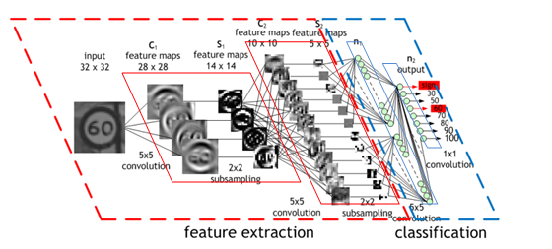
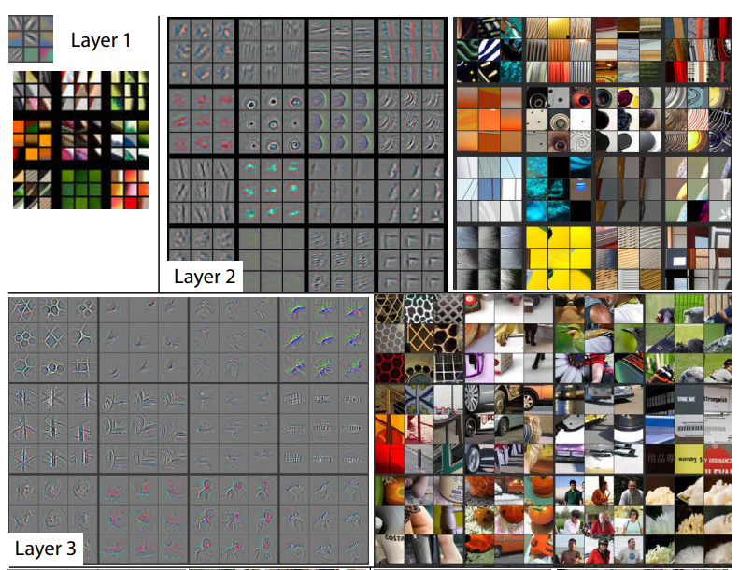
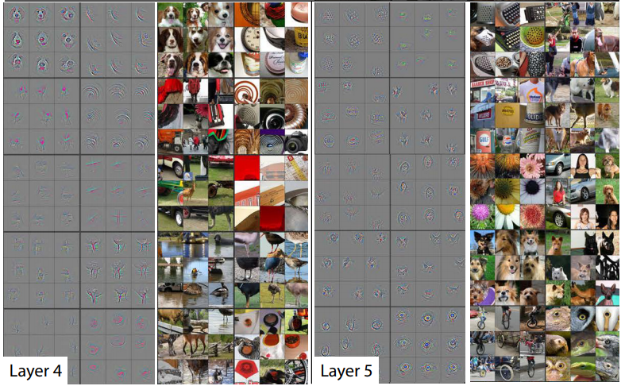
Under the hood...
Images retrieved from [1] and [2]
Notes:
This is not only limited to images. I’m taking these as example computer vision experiments are ubiquitous. In engineering and science research data, we can also do feature extraction from those numbers and then classify them.

Slide 16
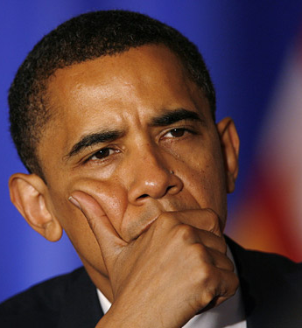
ML/AI applications in real world
So, how do you actually use ML/AI?
Where do you collect the data from? How do you use it to solve problems of the real world?
Notes:
Now, we talk about how ML/AI fuses with EEE.

Slide 17
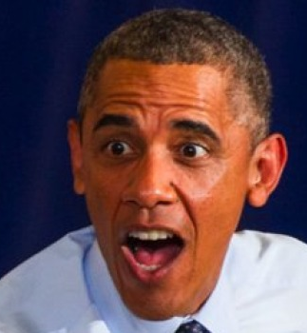
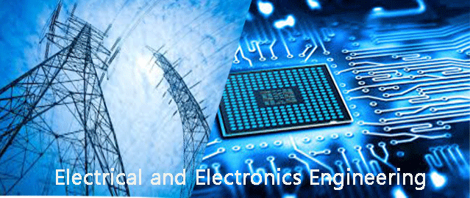
ML/AI applications in real world
So, how do you actually use ML/AI?
Where do you collect the data from? How do you use it to solve problems of the real world?
Signals Sensors Data ML
Notes:
Now, we talk about how ML/AI fuses with EEE.

Slide 18

ML and Signal Processing?
IEEE Signal Processing Society
https://www.youtube.com/watch?v=mexN6d8QF9o

Slide 19
ML and Robotics?
Shkurti, Florian, et al. "Underwater multi-robot convoying using visual tracking by detection." Intelligent Robots and Systems (IROS), 2017
IEEE/RSJ International Conference on. IEEE, 2017.
https://www.youtube.com/watch?v=Em7V-vBApHc

Slide 20
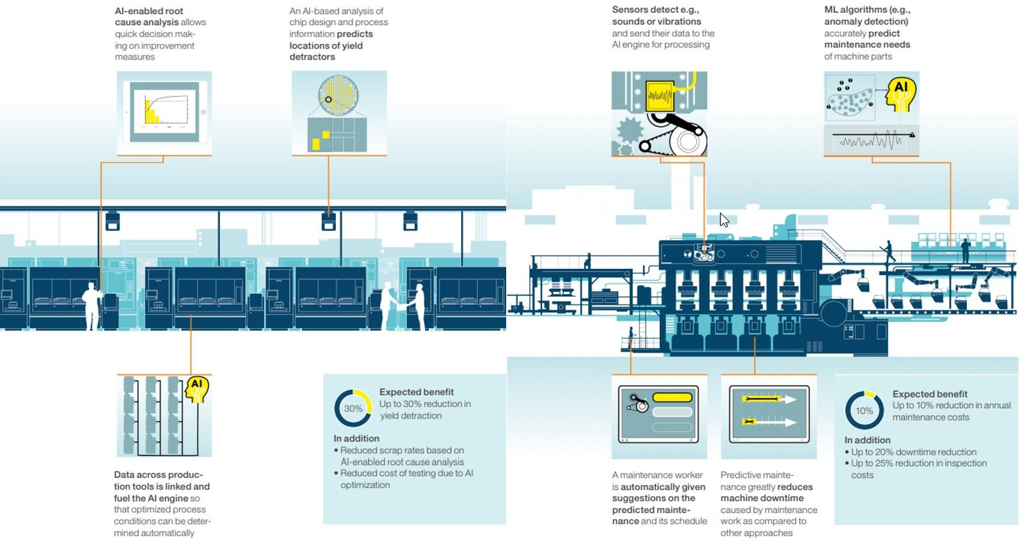
ML and Manufacturing (IoT)?
AI/ML everywhere??

Slide 21
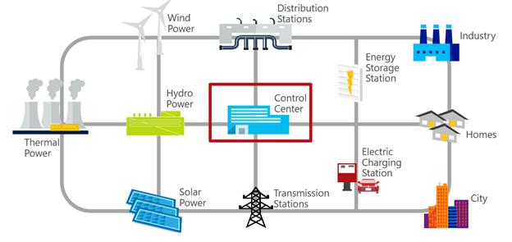

ML and Power Systems?
Load/Demand Forecasting
Fault Detection and Classification
Weather/ Wind Forecasting

Slide 22
Resources
Programming basics:
Scratch: https://scratch.mit.edu/
Blockly-games: https://blockly-games.appspot.com/?lang=en
Python:
https://www.sololearn.com/Course/Python/

Slide 23
References
[1] M. D. Zeiler and R. Fergus, “Visualizing and Understanding Convolutional Networks,” in European conference on computer vision, 2014, pp. 818–833.
[2] “Convolutional Neural Network (CNN),” NVIDIA Developer, 03-Aug-2018. [Online]. Available: https://developer.nvidia.com/discover/convolutional-neural-network. [Accessed: 03-Sep-2018].

